Slide 1
VAS Community Program
Project:
Better English community at
VAS Primary students
BA THANG HAI CAMPUS
Instroductor:…………………………………………………………………
By: Lishanth, Thanh Huy, Khanh Quoc, Ngoc Thuong, Kha Di, Phuc Mai, Min Seo, Minh Khoa, Ba Thanh

Slide 2
Overview:
Target students: VAS Primary students – newcomers and new students
School is best environment to practice English.
Inspire, motivate and boost Primary students to speak in English outside class. Practice makes fluency!
Better VAS English community to bring VAS name and fame to all

Slide 3
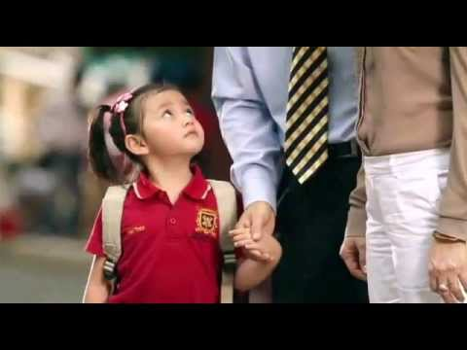
First day at school

Slide 4
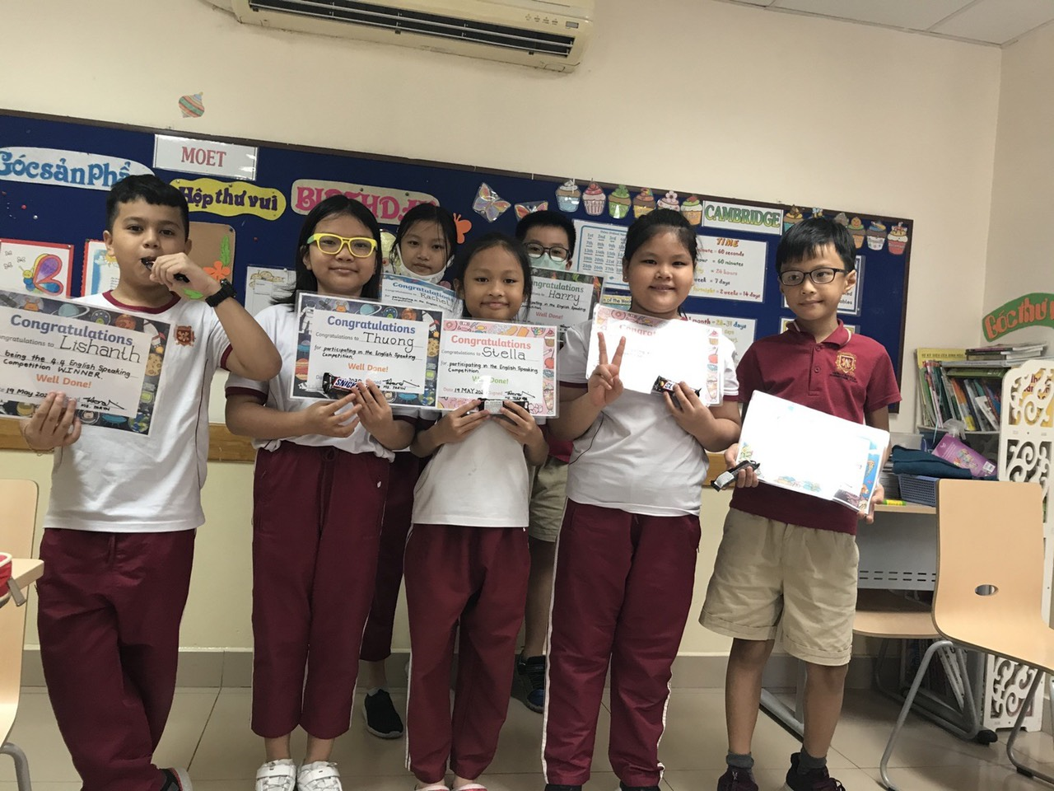
Practice makes fluency

Slide 5
Goals:
Target students: Primary students at VAS.
Motivate and boost students to use more English at school to get English speaking community in VAS Primary students.
Celebrate more activates, competition and awards to encourage students to use English.
Connect all Vasers in our system.
English exchange programs to help rural students speak English better.

Slide 6
Specifications:
Stage 1: English speaking Movement
Get badge as joining English speaking community
English speaking

Slide 7
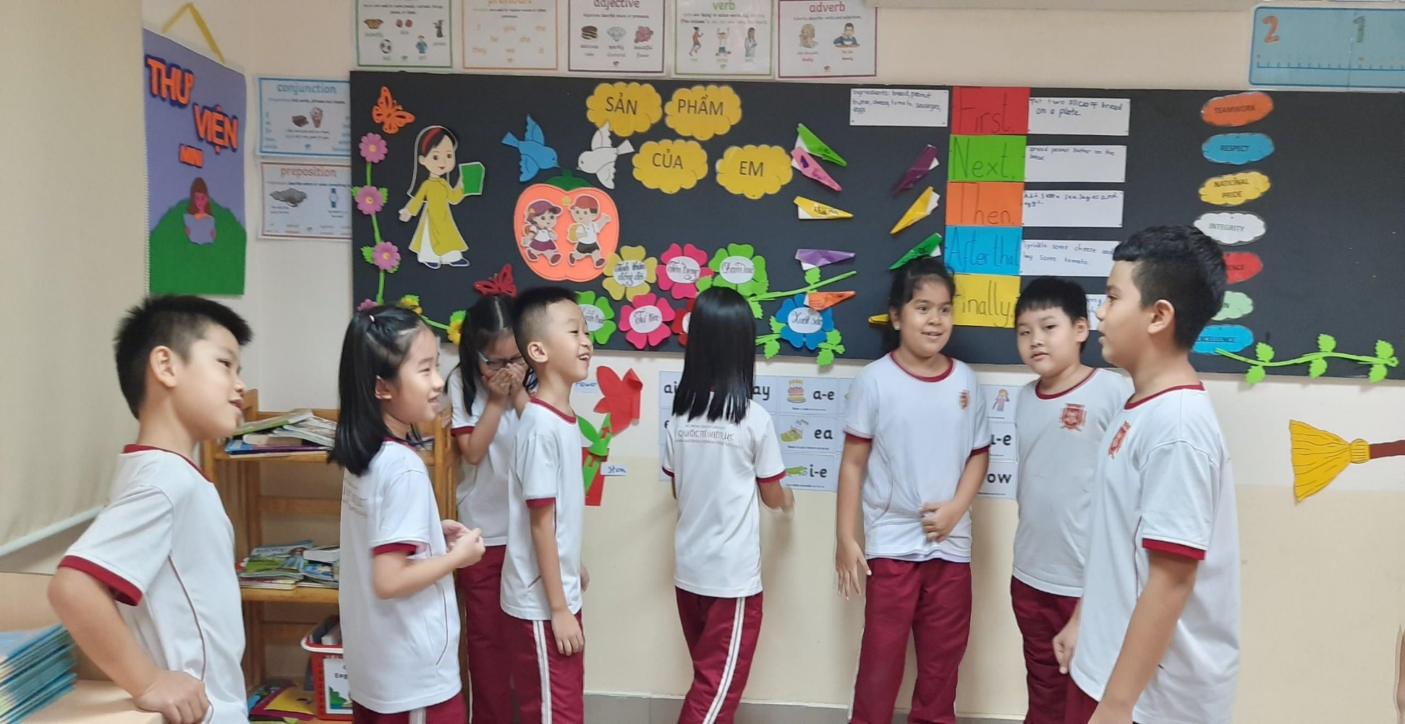
Introduce and motivate the English speaking movement

Slide 8
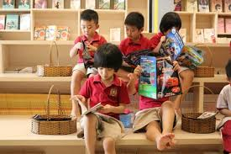
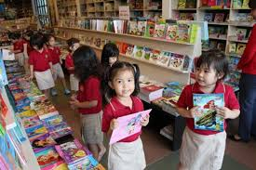
Stage 2: Celebrate activities to maintain and develop stronger English community
Reading at library:

Slide 9
Competition: “The voice of VASERS”
Encourage using Raz-kid everyday
Reading Raz-kid and record to join
Award: English Books, Certificate

Slide 10
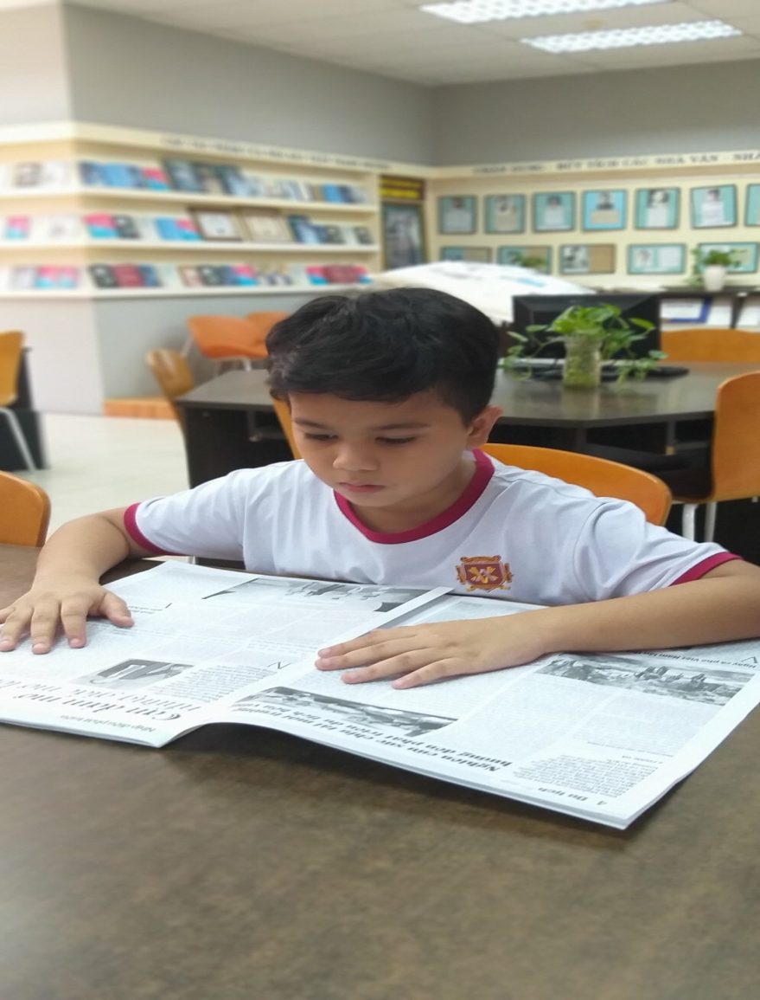
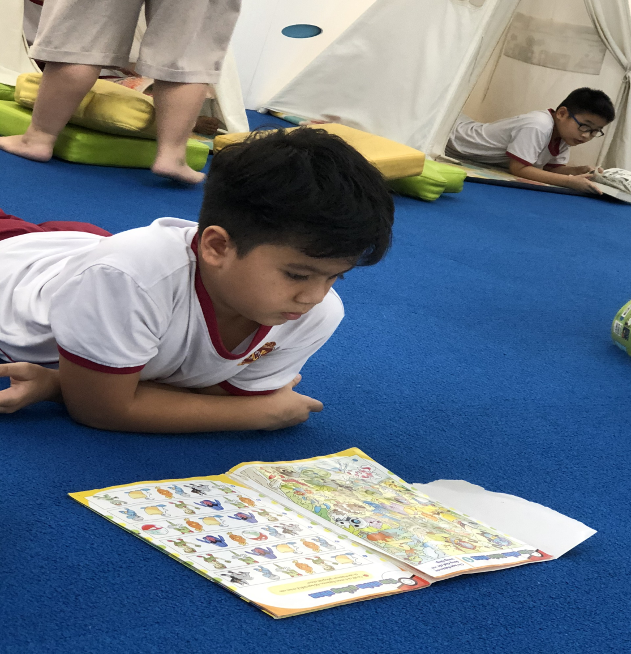
Reading club: Read share and review about the book you read

Slide 11
Board of Primary students
To Help, inspire, introduce and share experiences in completions:

Slide 12
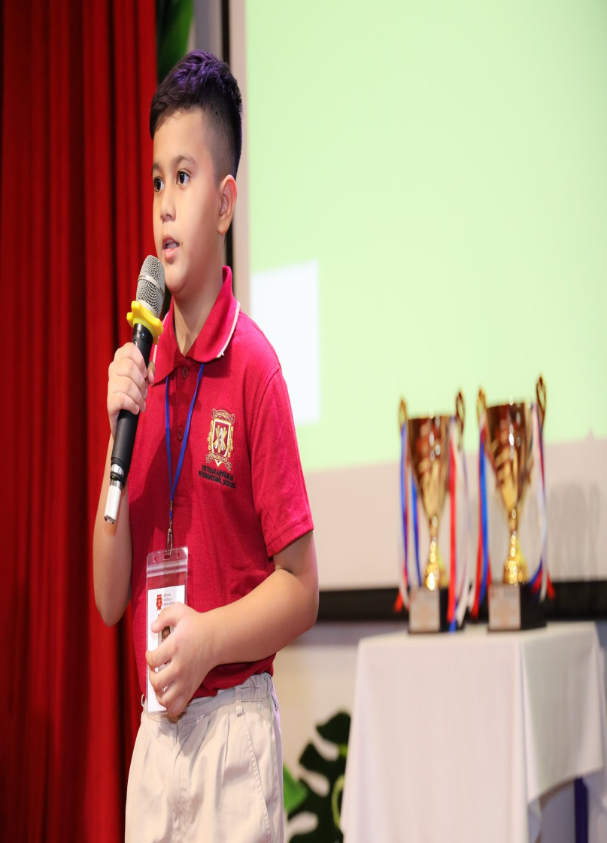
VAS English speaking Contest

Slide 13
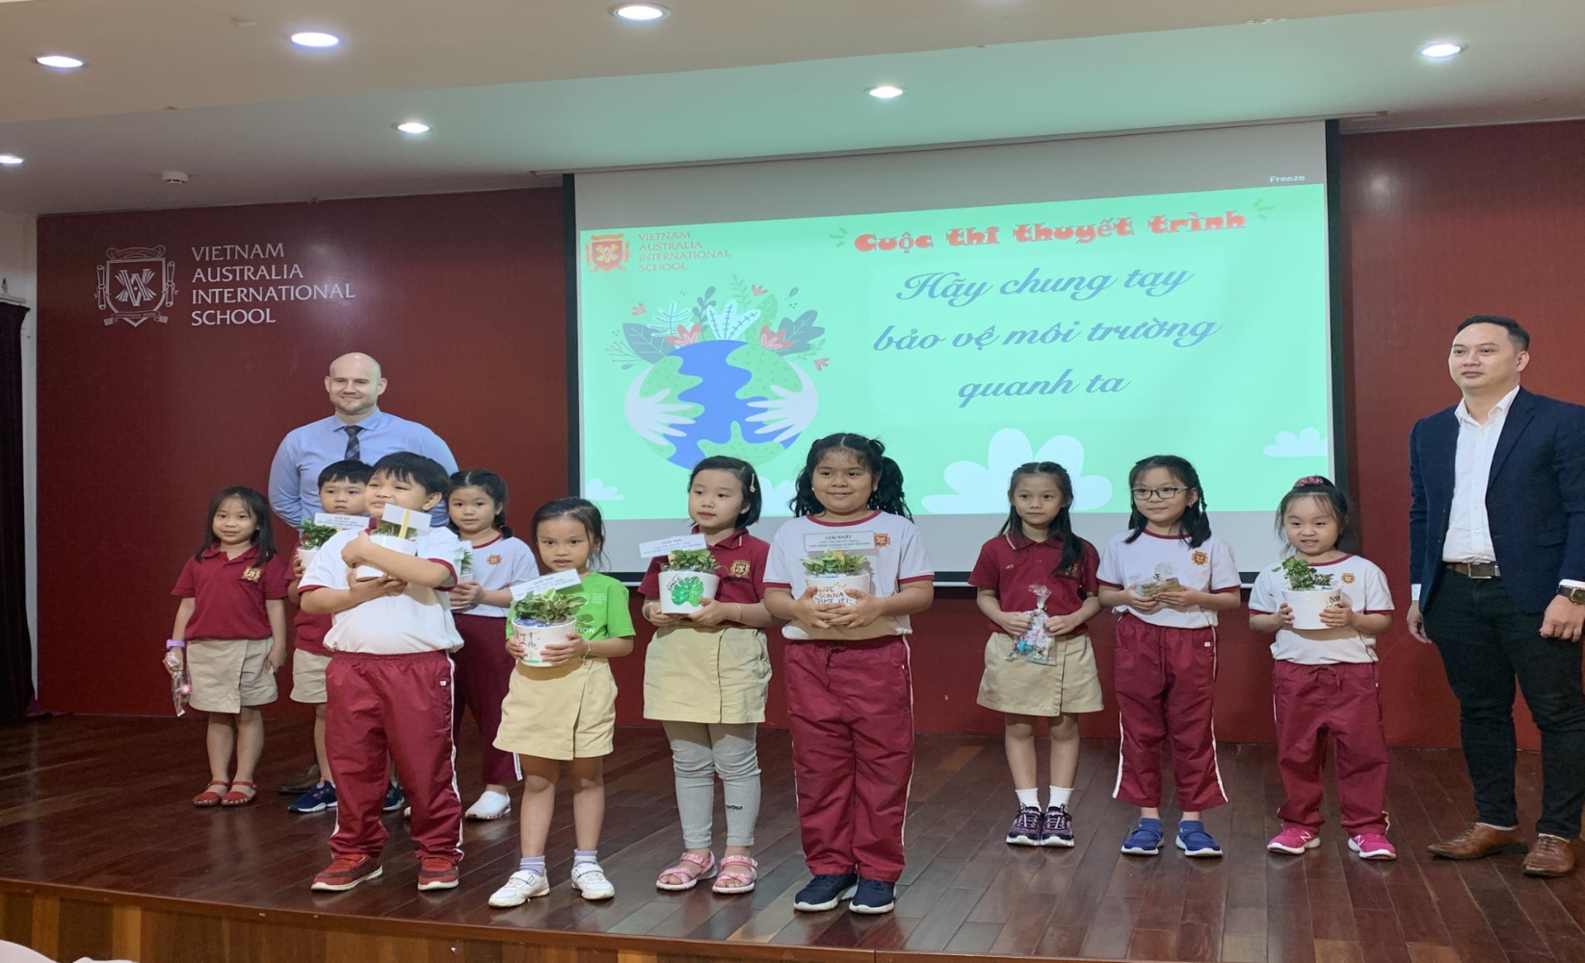
Primary student in VAS Talk 2020

Slide 14
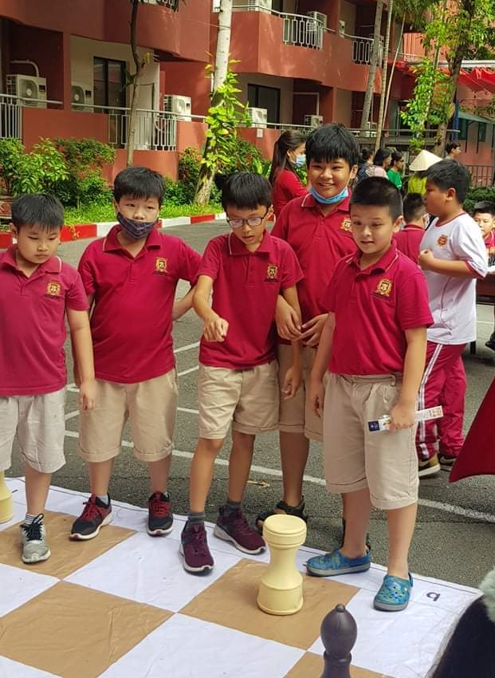
English sport clubs:

Slide 15
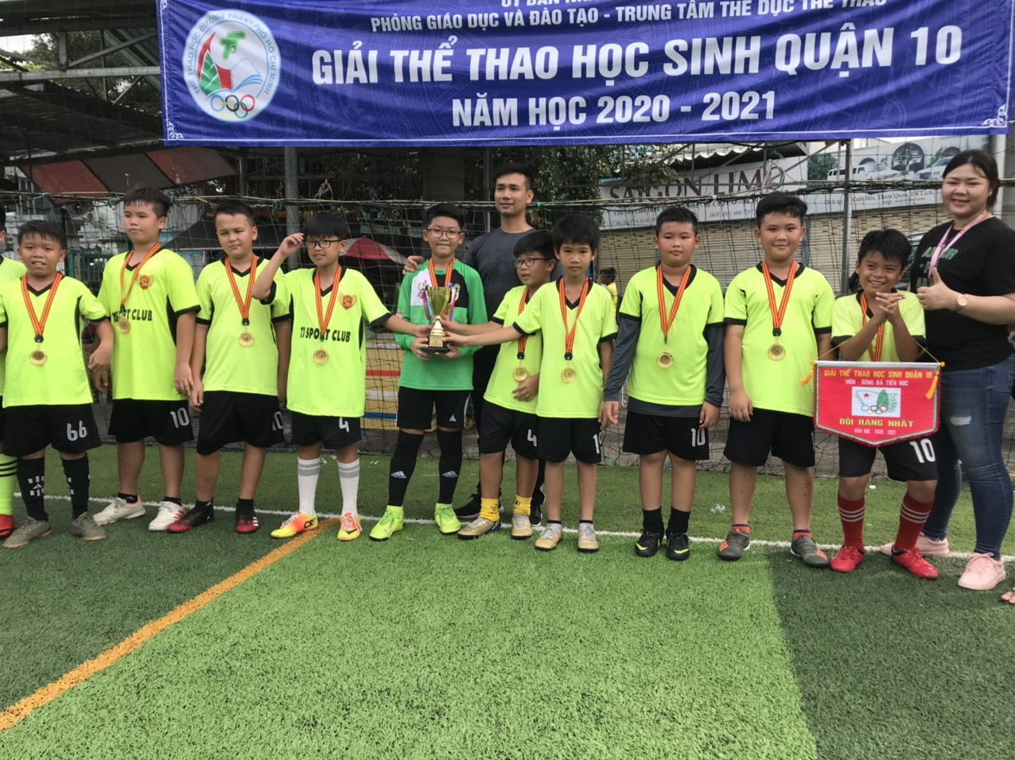
Football

Slide 16
Debating

Slide 17
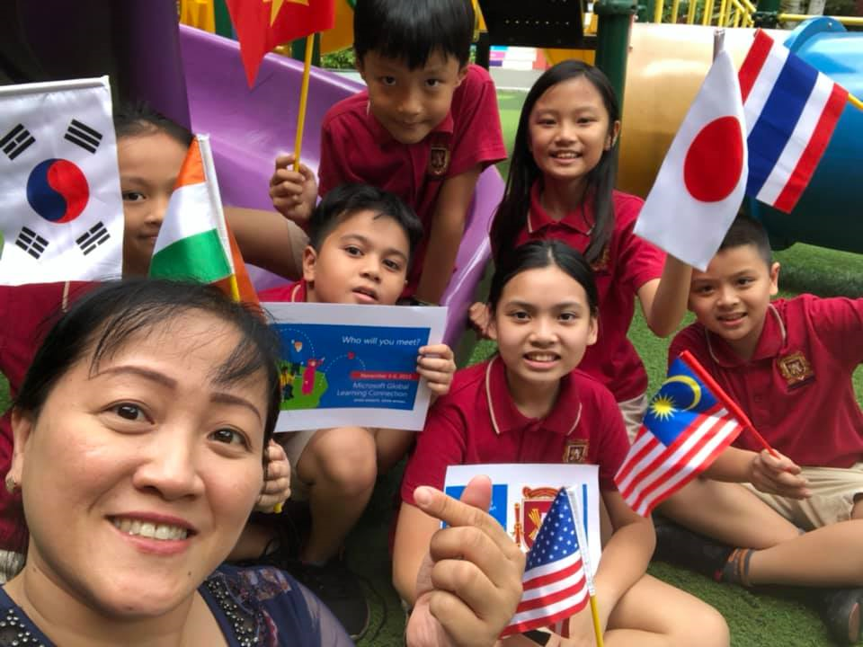
Bring VAS name and fame to outside

Slide 18
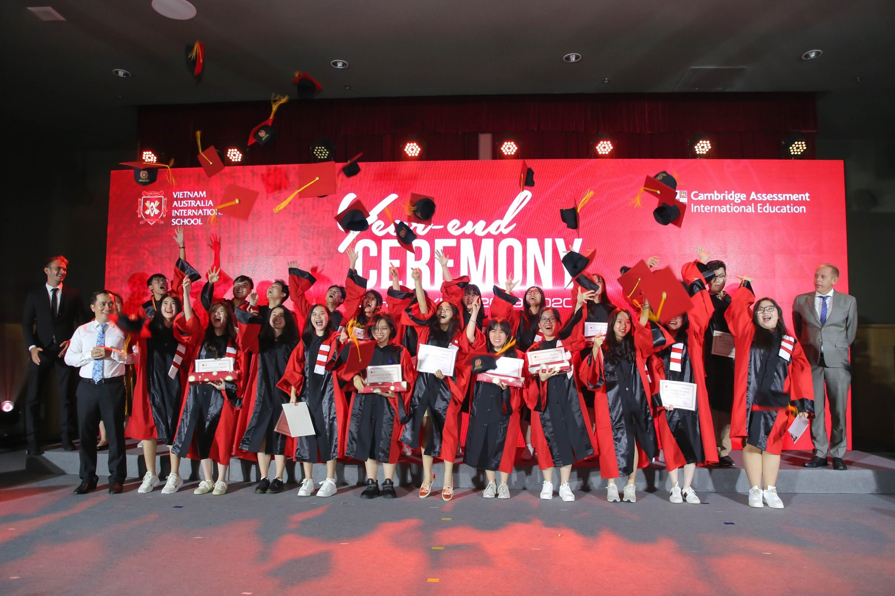
Proud of Vasers Community

Slide 19
English Exchange program in rural areas
Contact and organize English exchange program to help, guide and motivate other students surrounding Hochiminh city how to improve their English
Present English books and stories
Introduce VAS English community to outside.

Slide 20
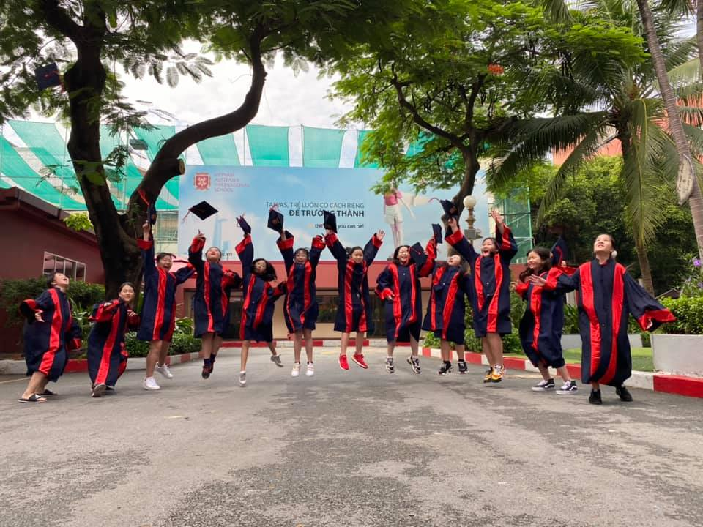
For “Better VAS English community”

